Slide 1
Human Activity Recognition
Edwin Candinegara

Slide 2
RESULT SUMMARY
Excel

Slide 3
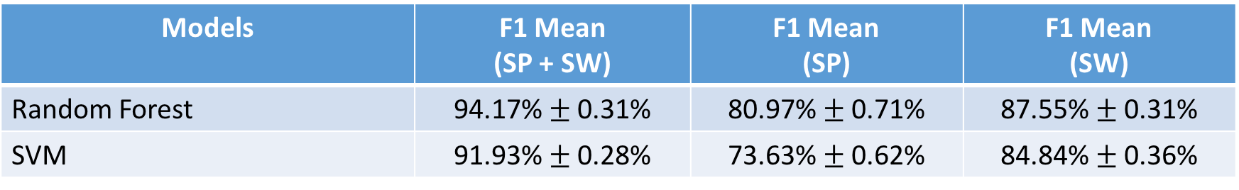
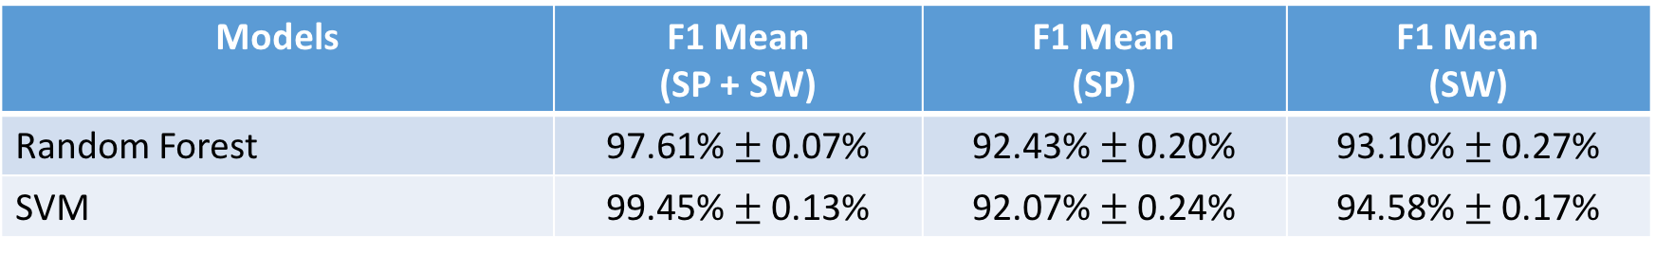
5-Fold CV → Accelerometer + Gyroscope
14 activities, 10 Hz, 2s window, ZERO MEAN ONLY!
14 activities, 10 Hz, 2s window, ORIGINAL + ZERO MEAN
Models | F1 Mean (SP + SW) | F1 Mean (SP) | F1 Mean (SW)
Random Forest | 94.17% $±$ 0.31% | 80.97% $±$ 0.71% | 87.55% $±$ 0.31%
SVM | 91.93% $±$ 0.28% | 73.63% $±$ 0.62% | 84.84% $±$ 0.36%
Models | F1 Mean (SP + SW) | F1 Mean (SP) | F1 Mean (SW)
Random Forest | 97.61% $±$ 0.07% | 92.43% $±$ 0.20% | 93.10% $±$ 0.27%
SVM | 99.45% $±$ 0.13% | 92.07% $±$ 0.24% | 94.58% $±$ 0.17%

Slide 4
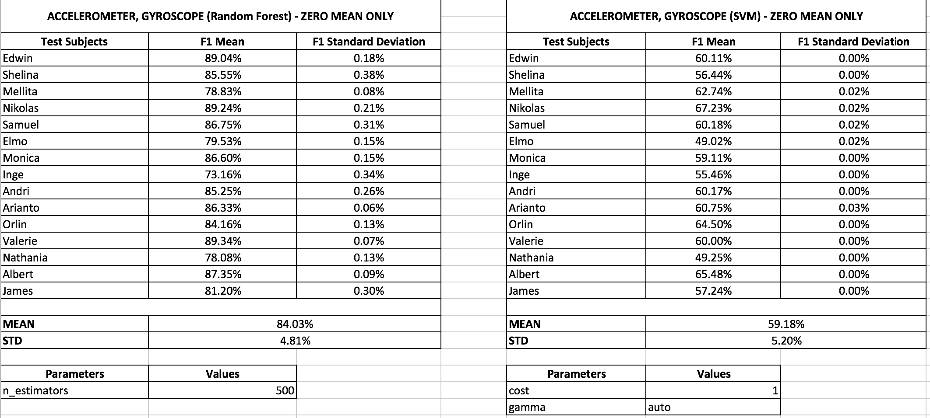

Slide 5
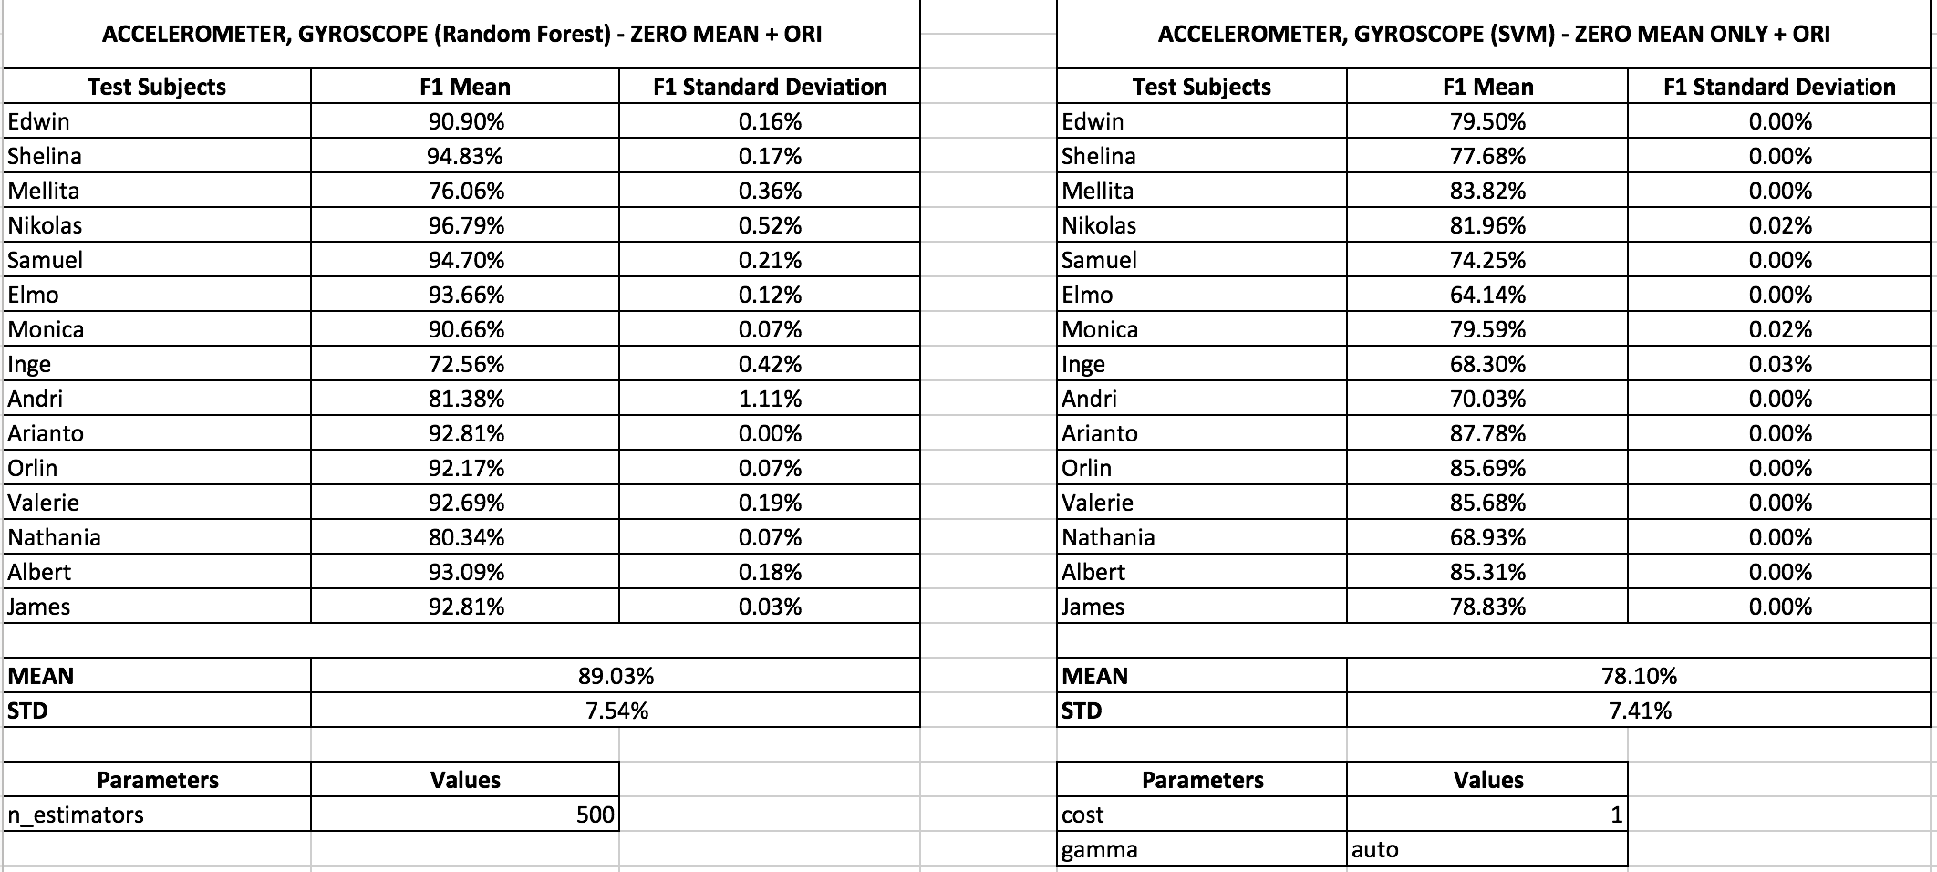

Slide 6

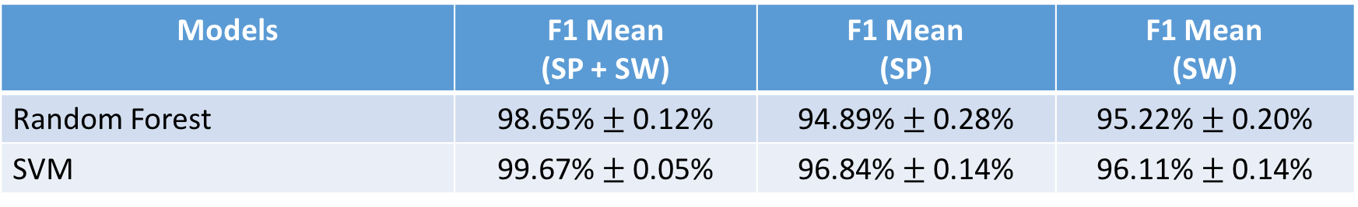
5-Fold CV → Acc + Gyroscope + Barometer
14 activities, 10 Hz, 2s window, ZERO MEAN ONLY!
14 activities, 10 Hz, 2s window, ORIGINAL + ZERO MEAN
Models | F1 Mean (SP + SW) | F1 Mean (SP) | F1 Mean (SW)
Random Forest | 95.59% $±$ 0.27% | 82.67% $±$ 0.45% | 90.14% $±$ 0.37%
SVM | 92.36% $±$ 0.32% | 74.09% $±$ 0.36% | 86.90% $±$ 0.36%
Models | F1 Mean (SP + SW) | F1 Mean (SP) | F1 Mean (SW)
Random Forest | 98.65% $±$ 0.12% | 94.89% $±$ 0.28% | 95.22% $±$ 0.20%
SVM | 99.67% $±$ 0.05% | 96.84% $±$ 0.14% | 96.11% $±$ 0.14%

Slide 7
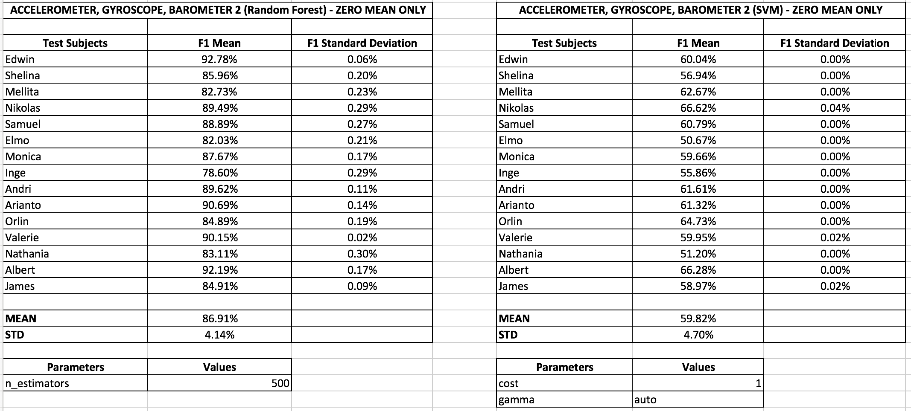

Slide 8
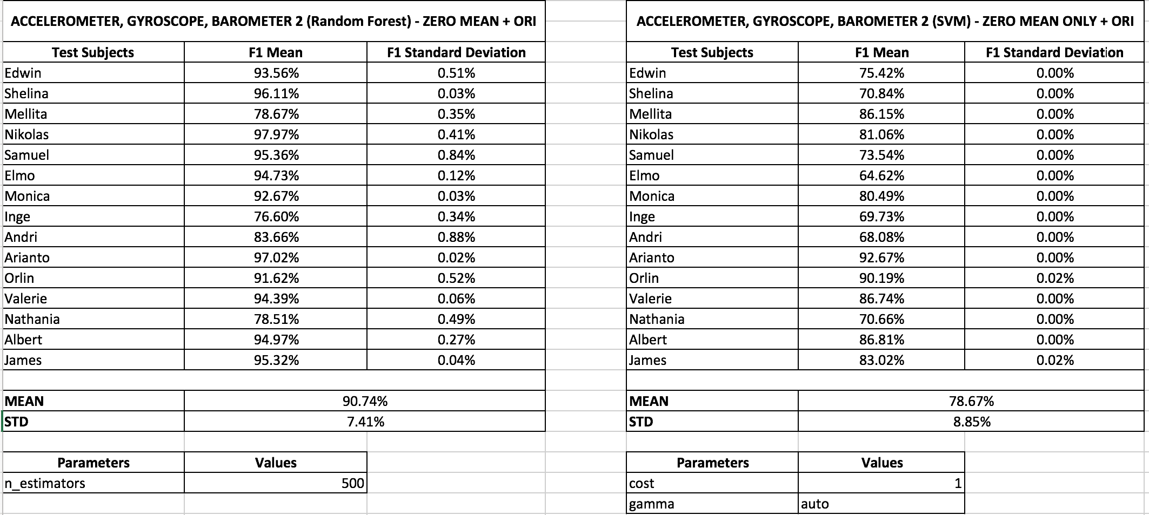

Slide 9
FEATURES COMPARISON
Complex Human Activity Recognition Using Smartphone and Wrist-Worn Motion Sensors

Slide 10
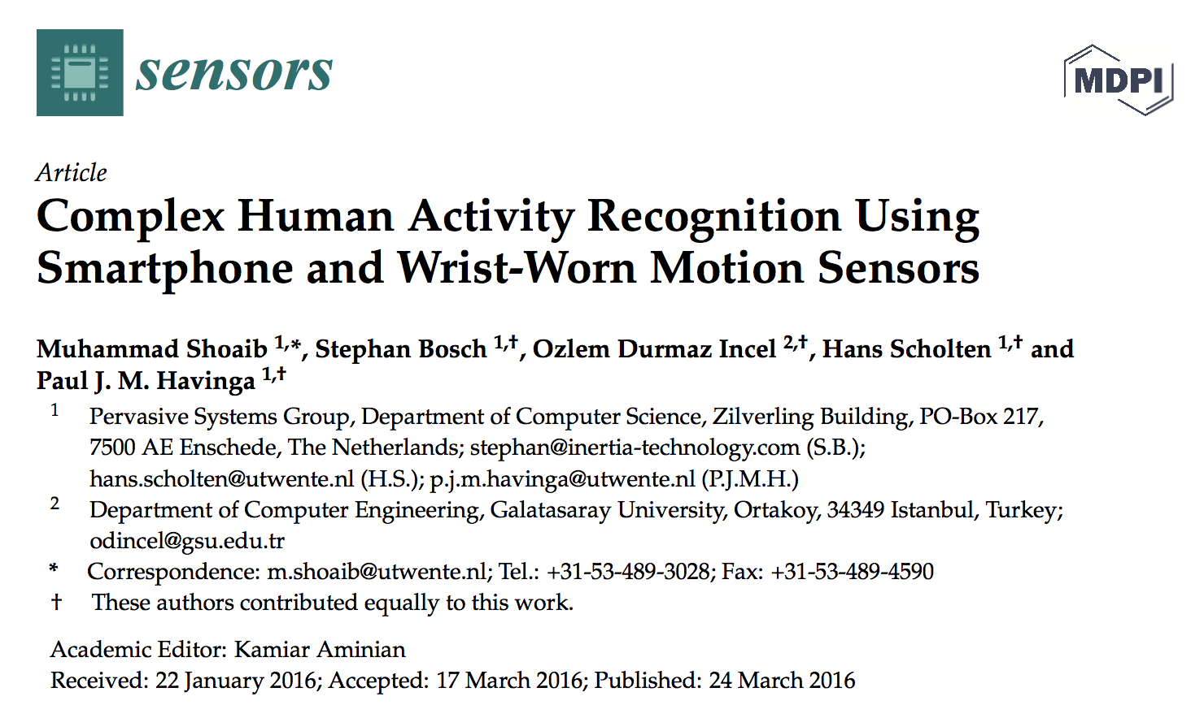

Slide 11
Summary
10 subjects (23-35 y.o.)
Not all activities are performed by each subject
Use 2 smartphones → pocket + wrist
Features:
Mean, Standard Deviation, Min, Max, Semi Quartile, Median, Sum of the First 10 FFT Coefficient
50Hz, 2-30s window sizes
3 classifiers → kNN, Naive Bayes, Decision Tree
10-fold CV → without shuffling!

Slide 12
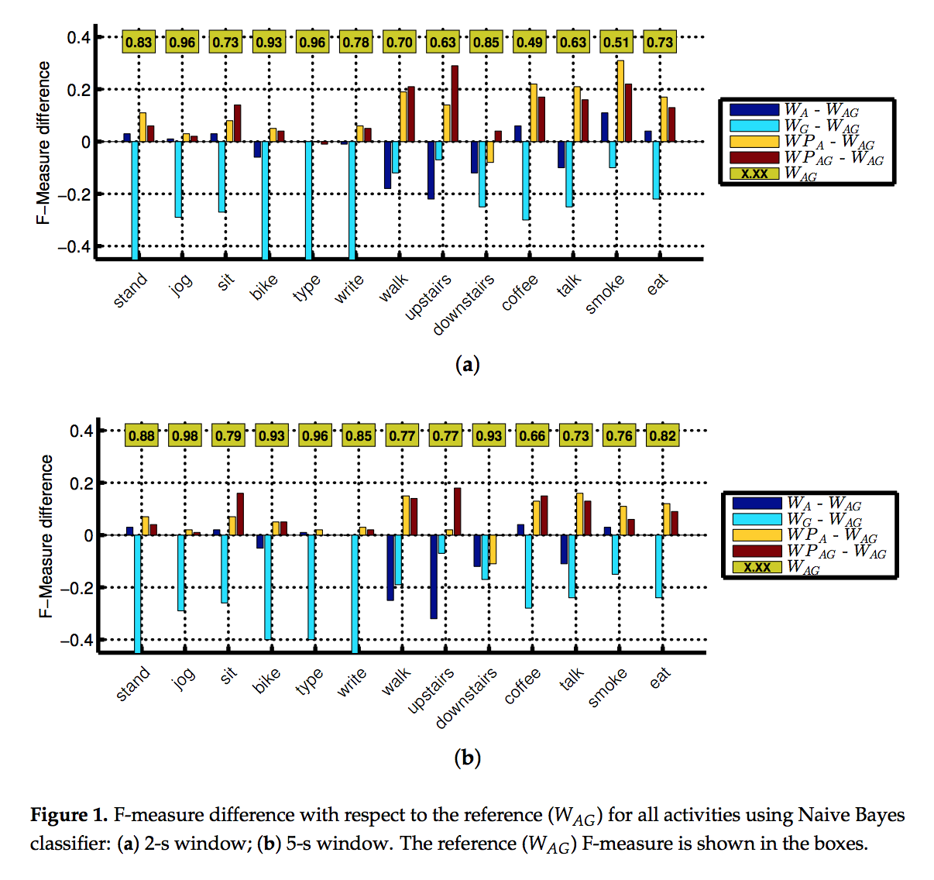
Notes:
Accelerometer + Gyroscope

Slide 13
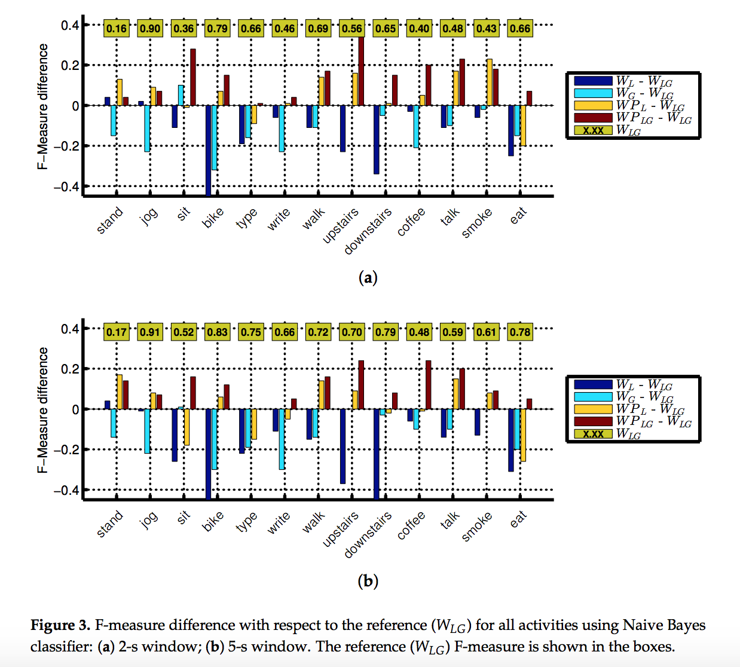
Notes:
Linear Accelerometer + Gyroscope

Slide 14
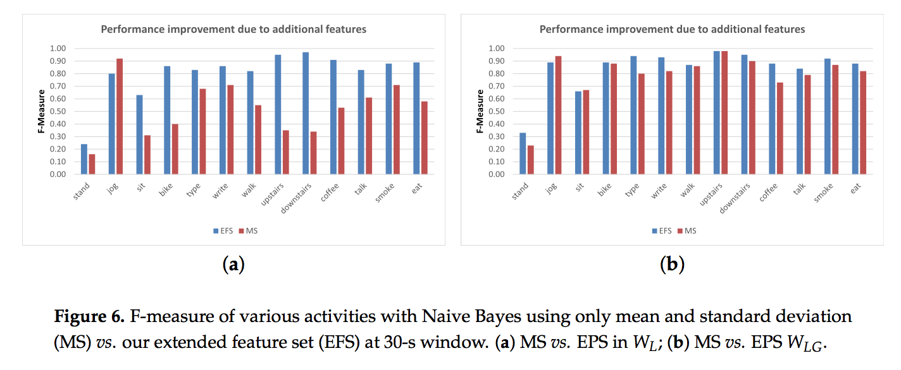

Slide 15
FEATURES COMPARISON
Smartwatch-based Activity Recognition: A Machine Learning Approach

Slide 16
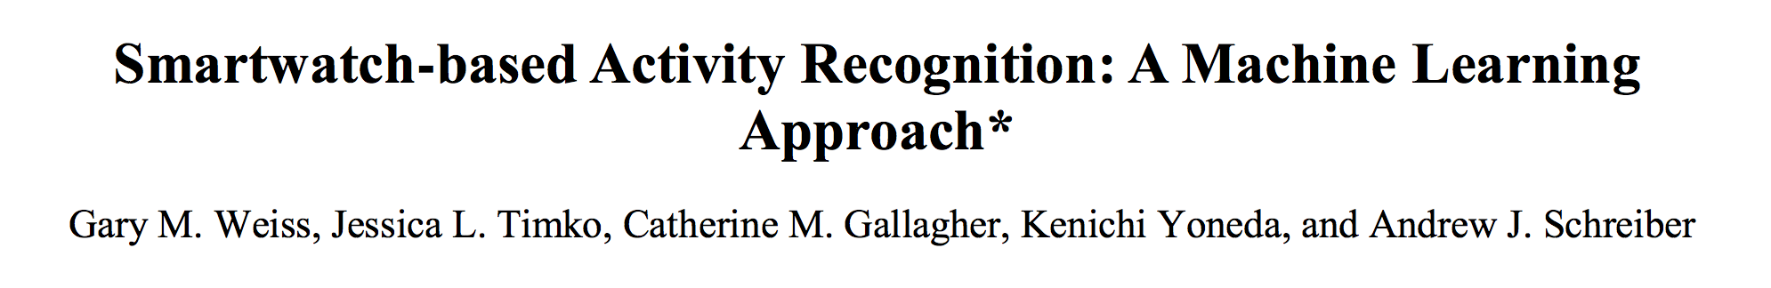
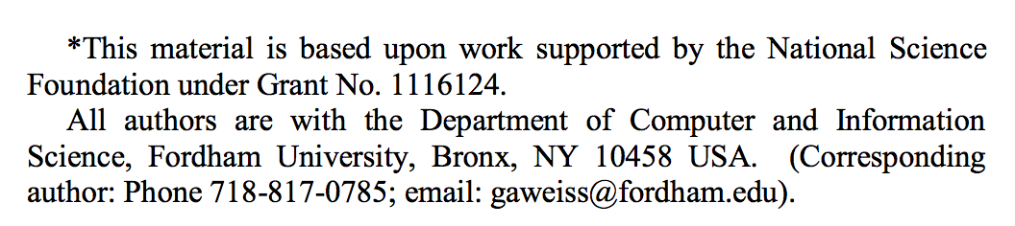

Slide 17
Summary
17 subjects, 18 activities
Smartphone, Smartwatch
43 Features (next slide)
20Hz, 10s window sizes
Classifiers → Random Forest, J48 Decision Tree, IB3 Instance-based Learning (kNN), Naive Bayes, MLP
Personal (using only the test subject’s data) Model → 10-fold CV
Impersonal Model → LOPO

Slide 18
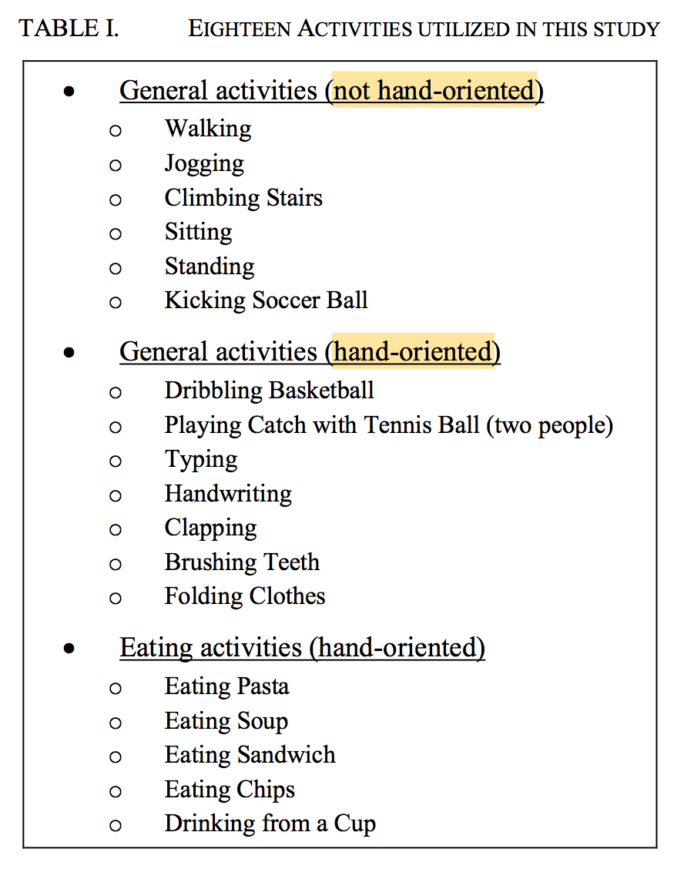

Slide 19
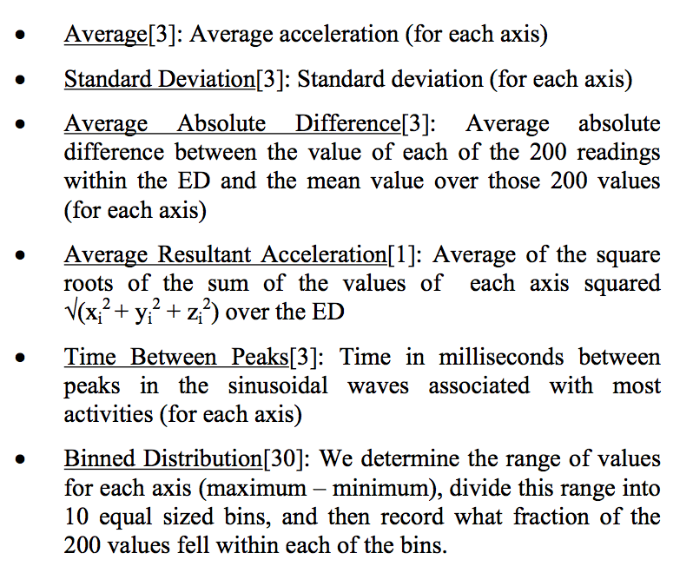
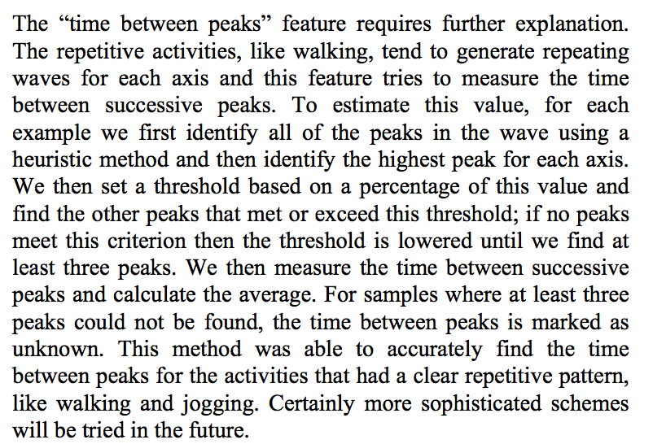
Notes:
heuristic but no explanation on the heuristic rule decision

Slide 20
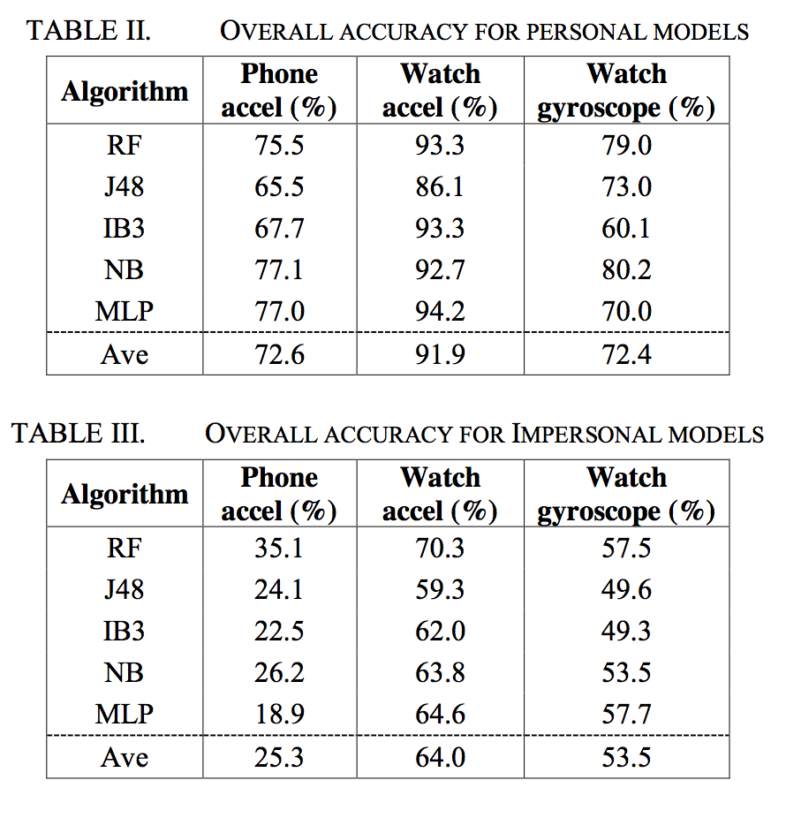

Slide 21
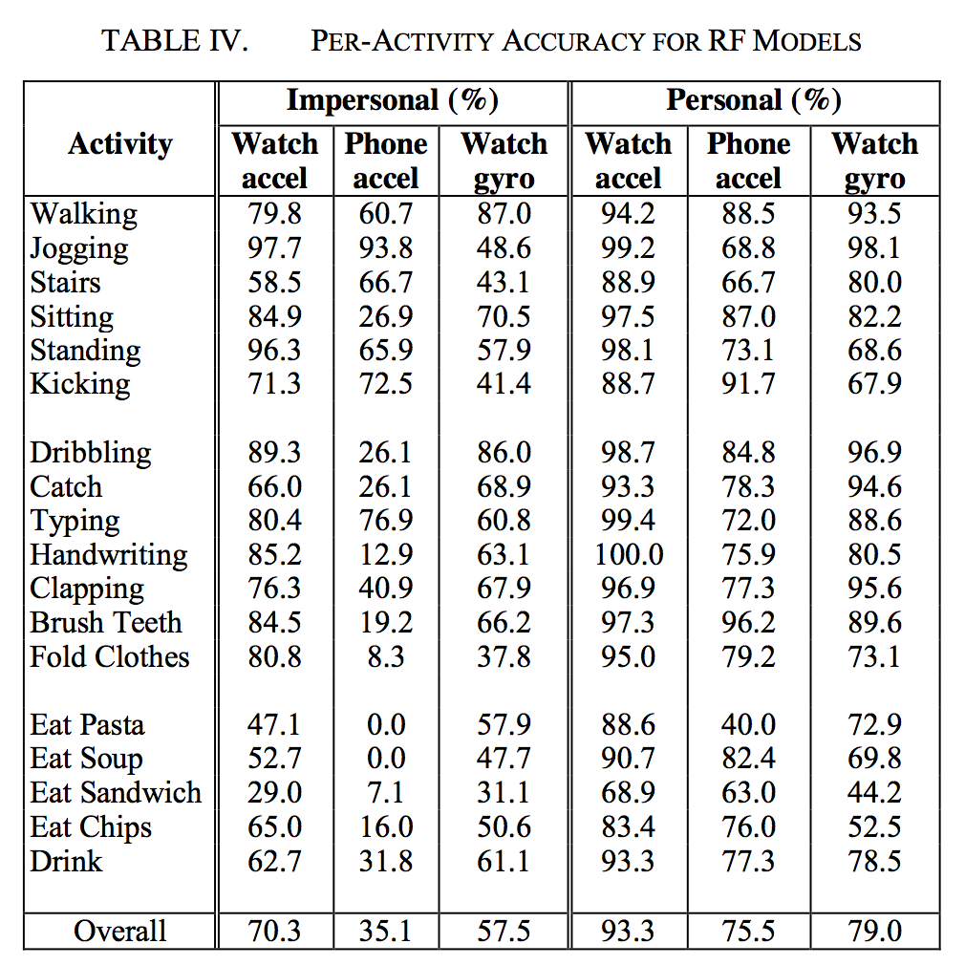

Slide 22
What’s next?
Interim report content?
Any feedback?
MDS PERMAP → Windows only ...
Features benchmarking

